Slide 1
Term Project for
CS673 – Software Engineering
Focused Study
(Iteration 1)
Project Presentation by
Siddhesh Dighe
Paridhi Talwar
Deepali Chawla
Pushkar Gharat
Sai Ramya Devineni
Ayush Bhaliya
Supriya

Slide 2
Team Members
Siddhesh Dighe - Team Leader Paridhi Talwar - Requirement Leader
Deepali Chawla- Configuration Leader Pushkar Gharat - Design Implementation Leader
Sai Ramya Devineni - QA Leader
Supriya - Backup QA Leader
Ayush Bhaliya - Security Leader

Slide 3


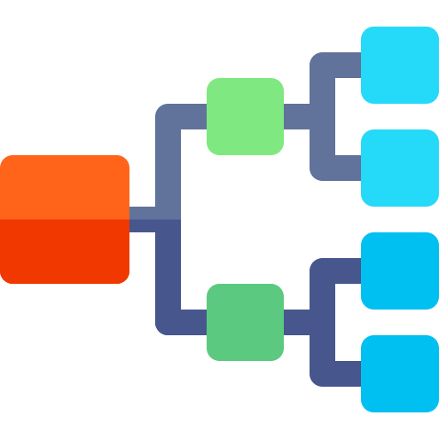


Focus for Iteration 1
Wireframes
User stories
High level Designs
Configuring automated tools
Implementing basic
functionality

Slide 4
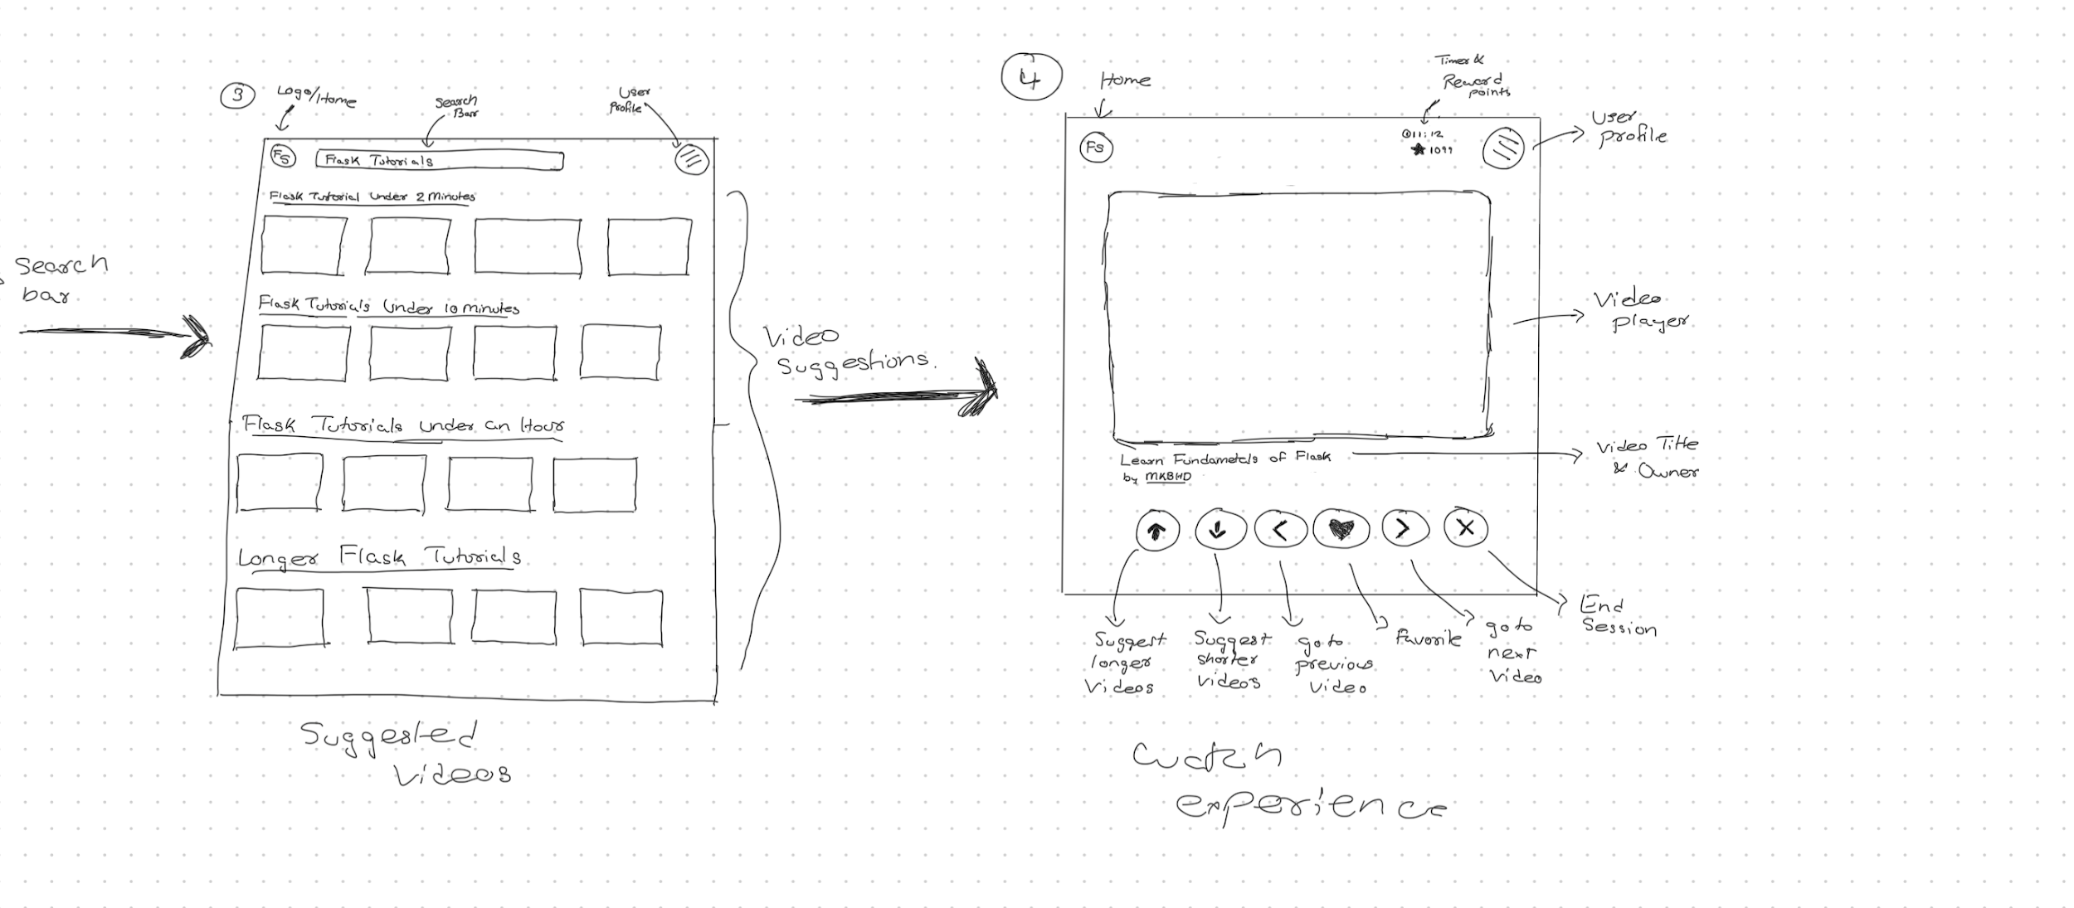
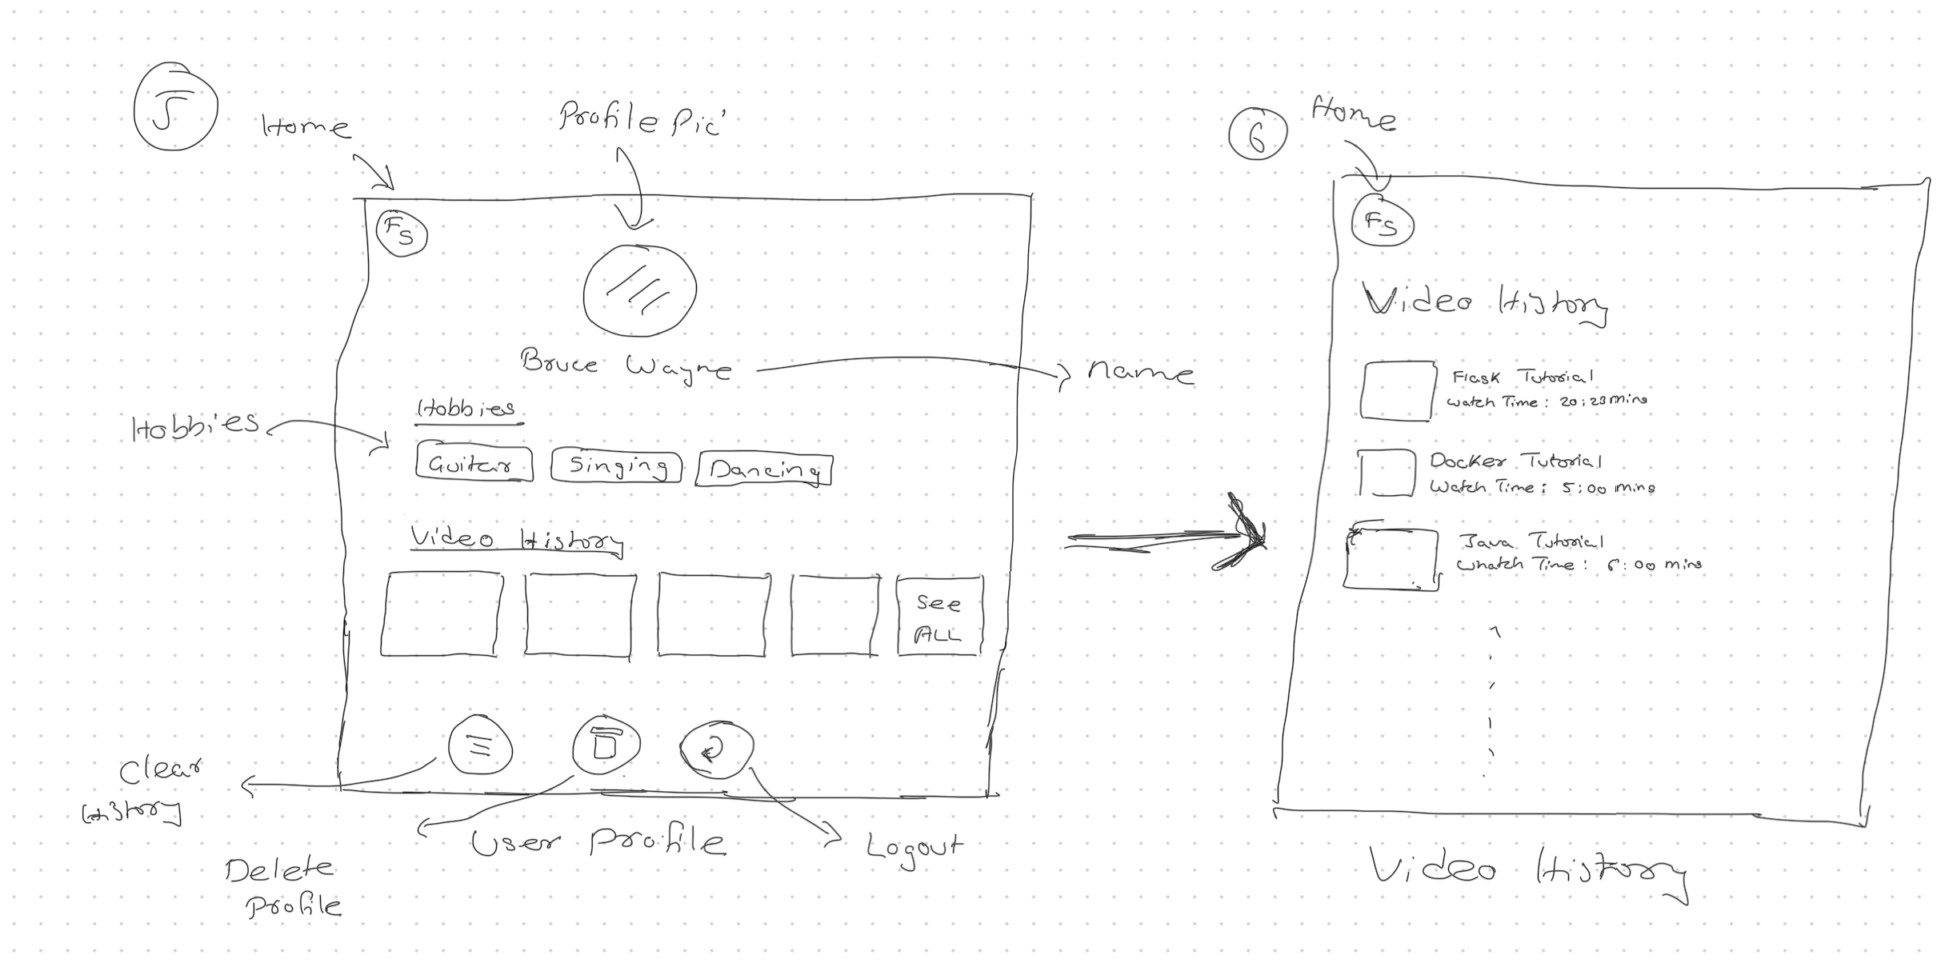
Wireframes
Low fidelity wireframes helped us visualize the flow of the app better
It also helped us identify & tackle some useability issues before we started development
Why low fidelity wireframes?
Its easy modify compared to high fidelity wireframes
Helped focus on the structure of the app rather than more peculiar design details

Slide 5
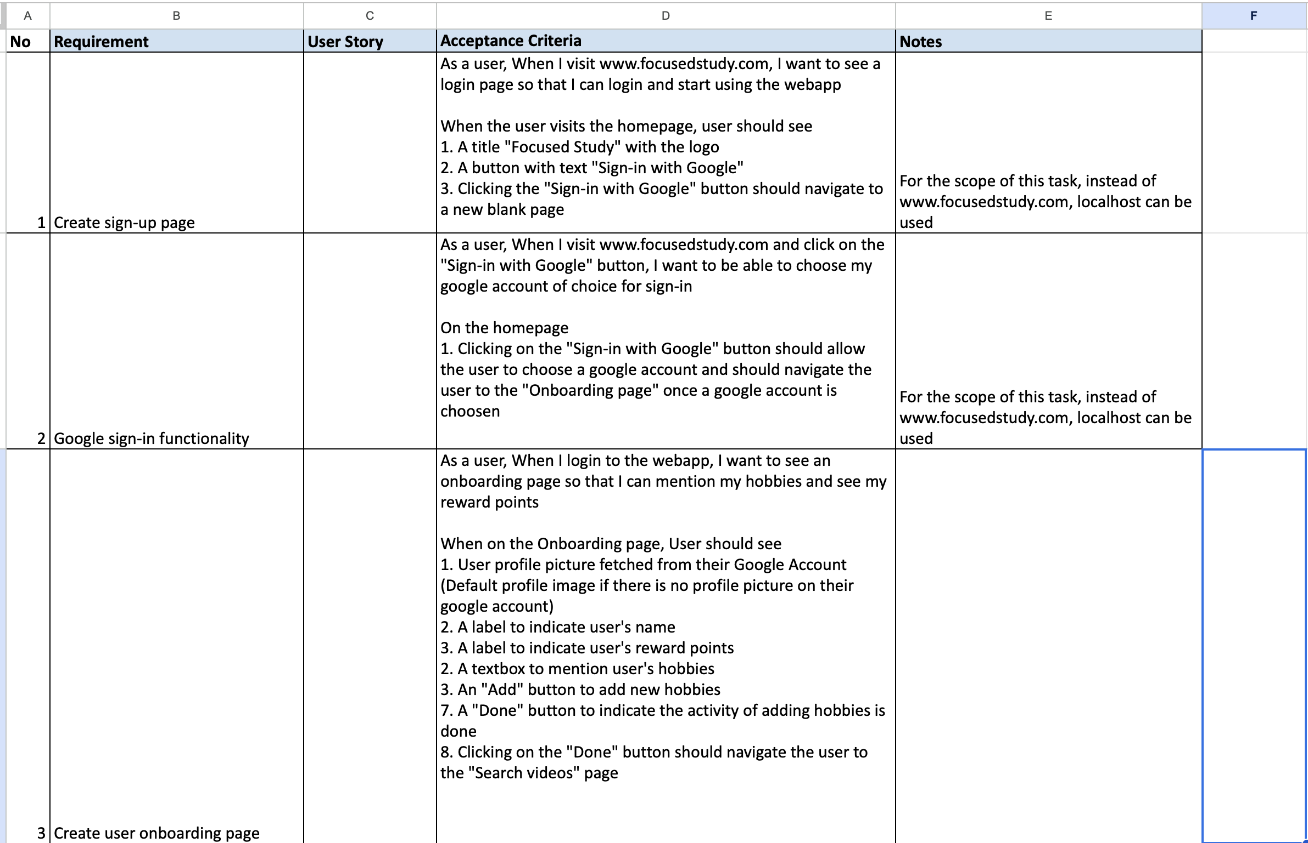
User Stories
With help of the wireframes, we could write user stories which were more detailed (down to each button on the screen)
This won’t just help us make the task more easy to understand but it also makes UI Testing easier and more organized

Slide 6
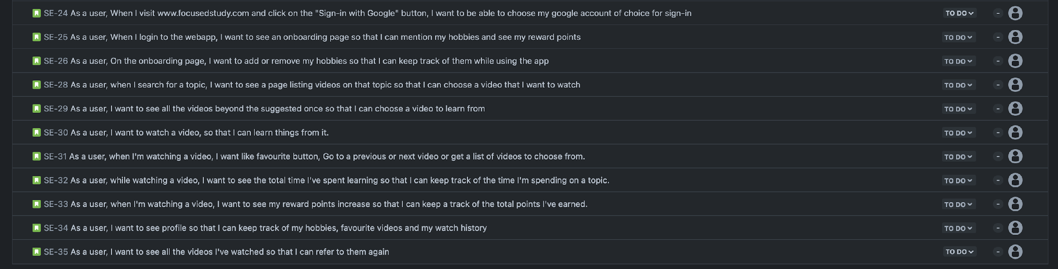
User Stories
Once each user story was reviewed, we added them to the jira board so that we can track them

Slide 7
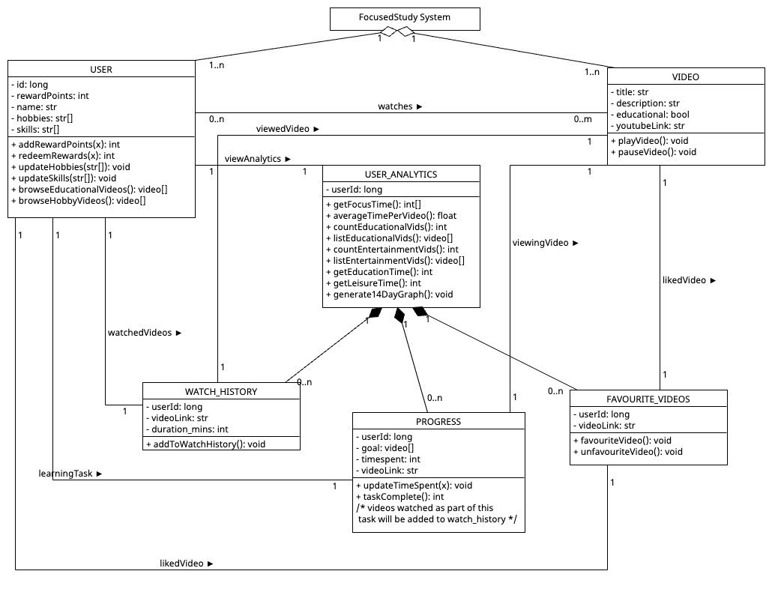
Class Diagram

Slide 8
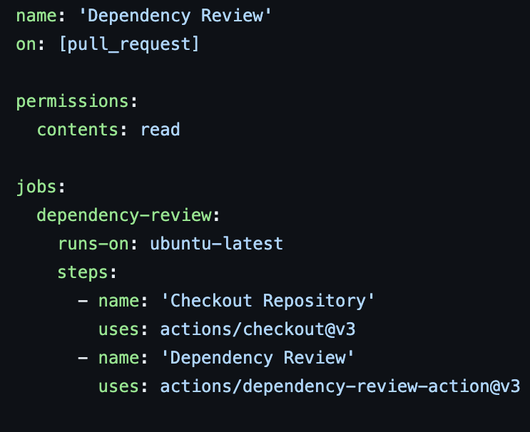
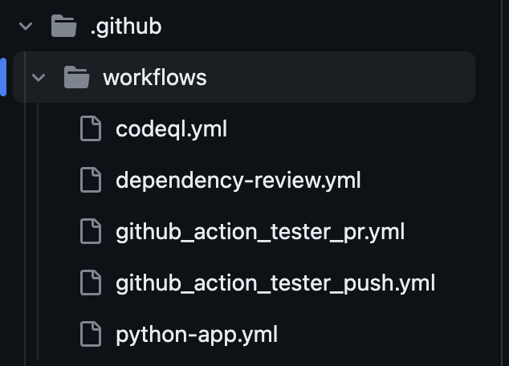
Configuring Automated tools

Slide 9
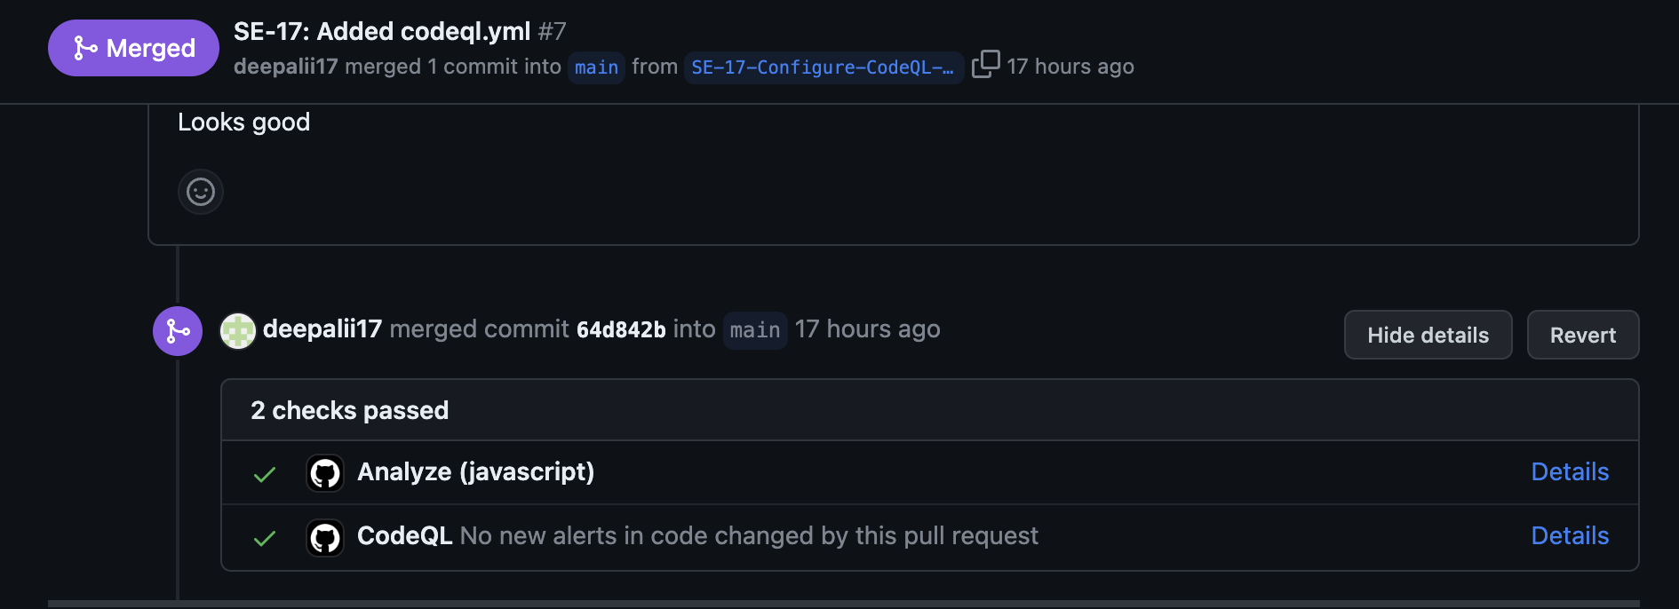
Configuring Automated tools

Slide 10
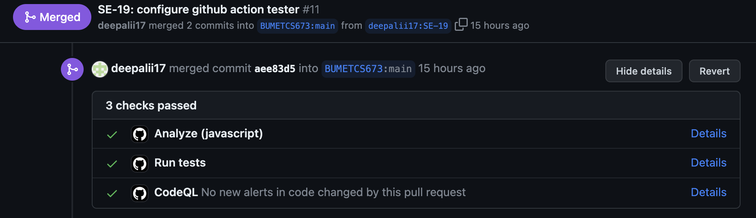
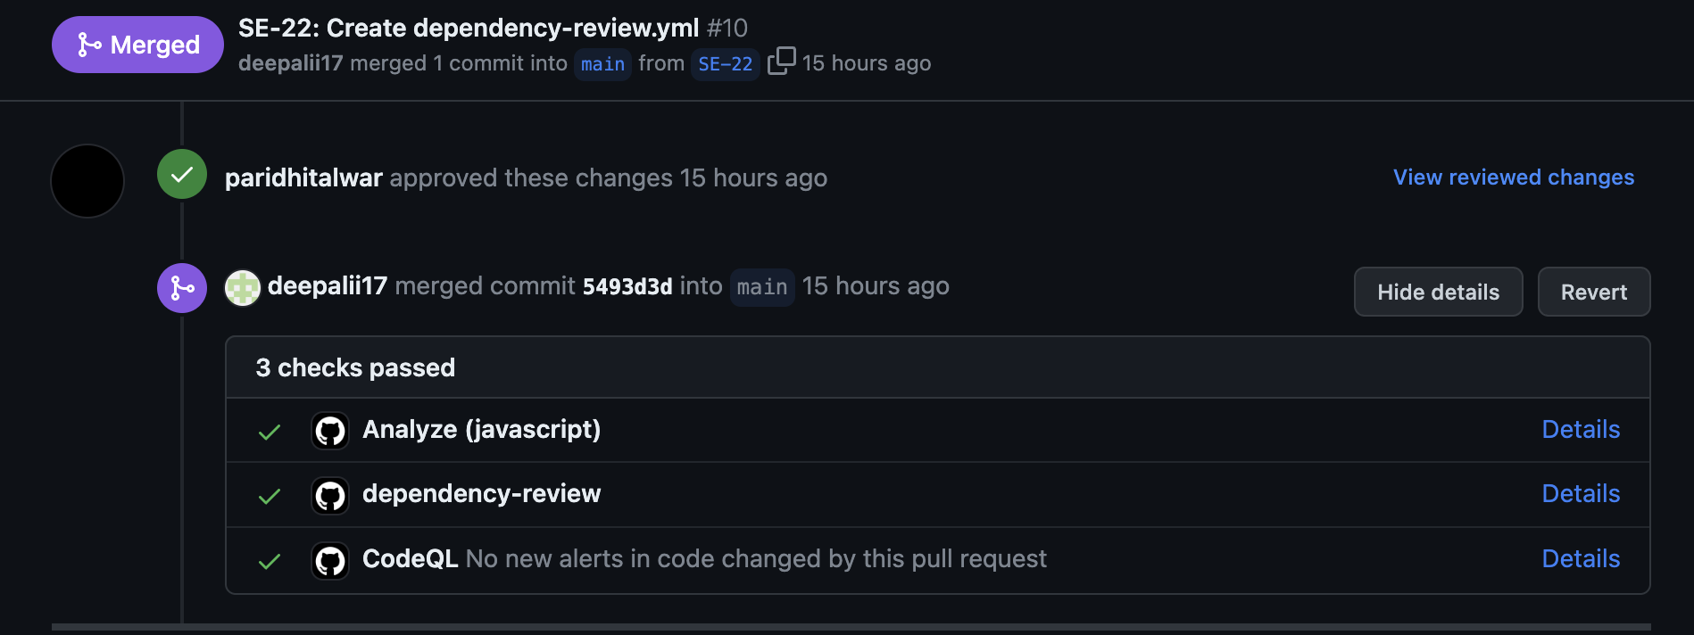
Configuring Automated tools

Slide 11
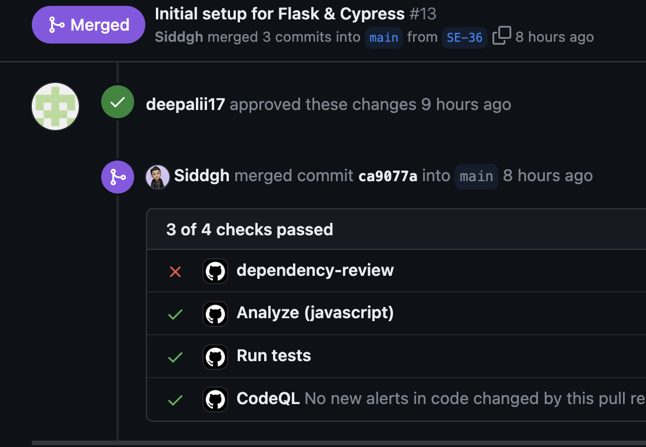
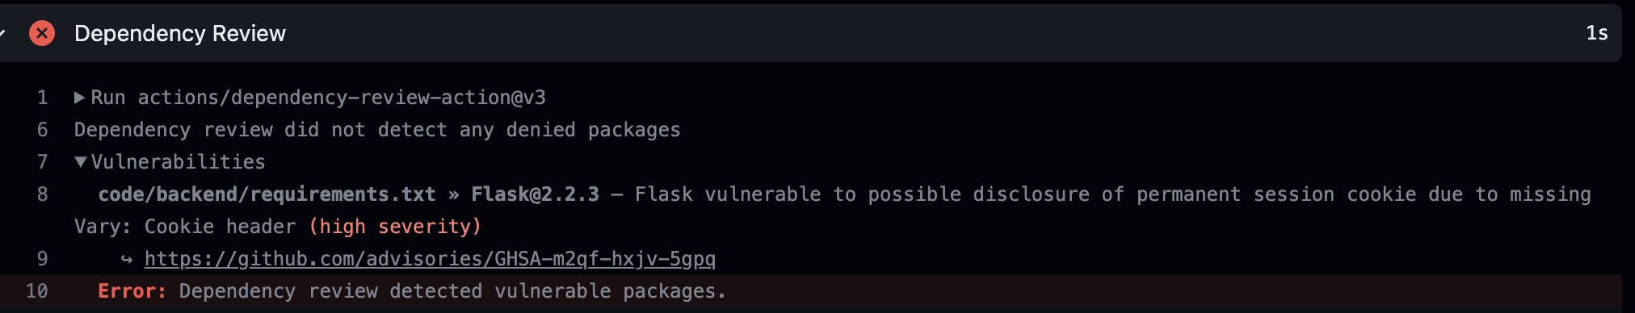
Configuring Automated tools

Slide 12
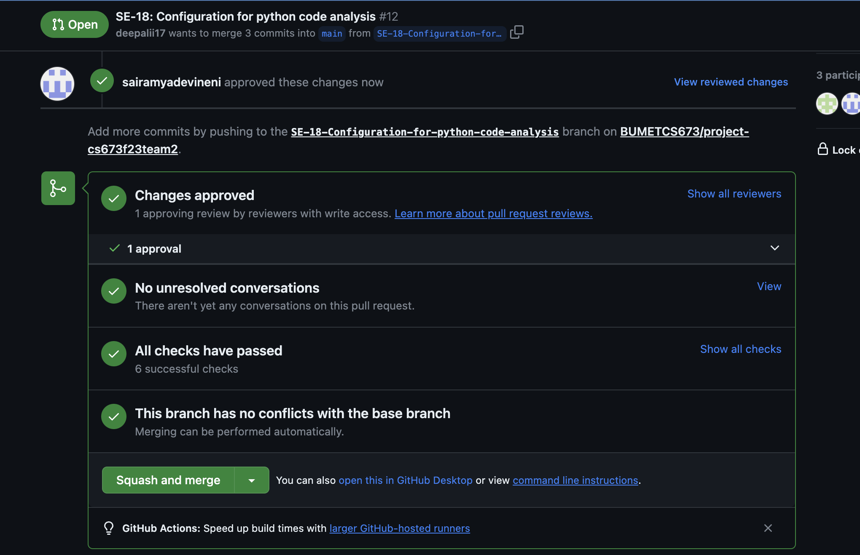
Configuring Automated tools

Slide 13
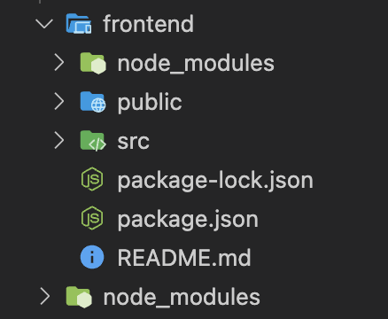
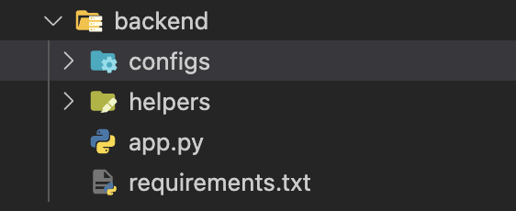
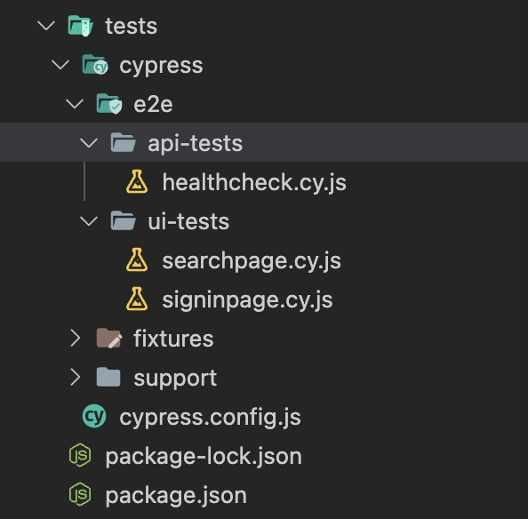
Project Structure
Backend
Frontend
Test cases

Slide 14
Demo Slides

Slide 15
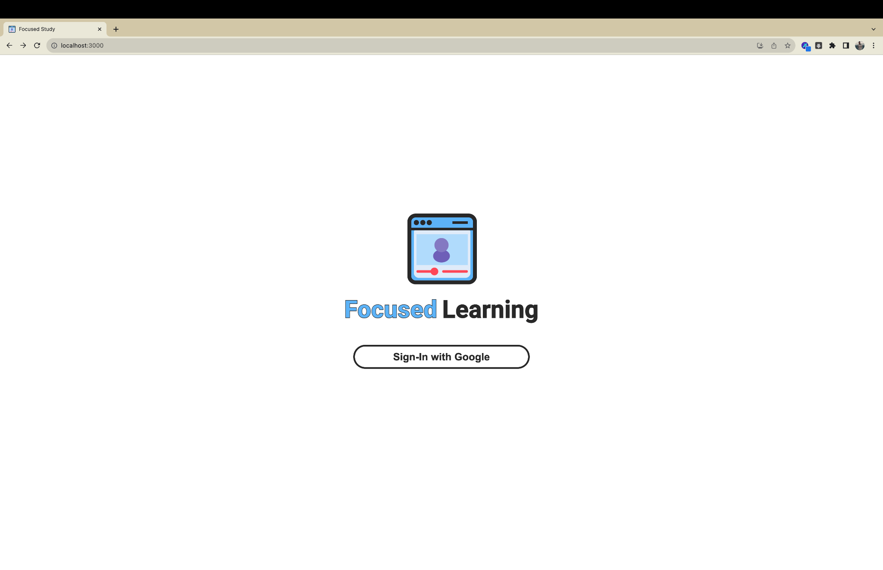
Login page

Slide 16
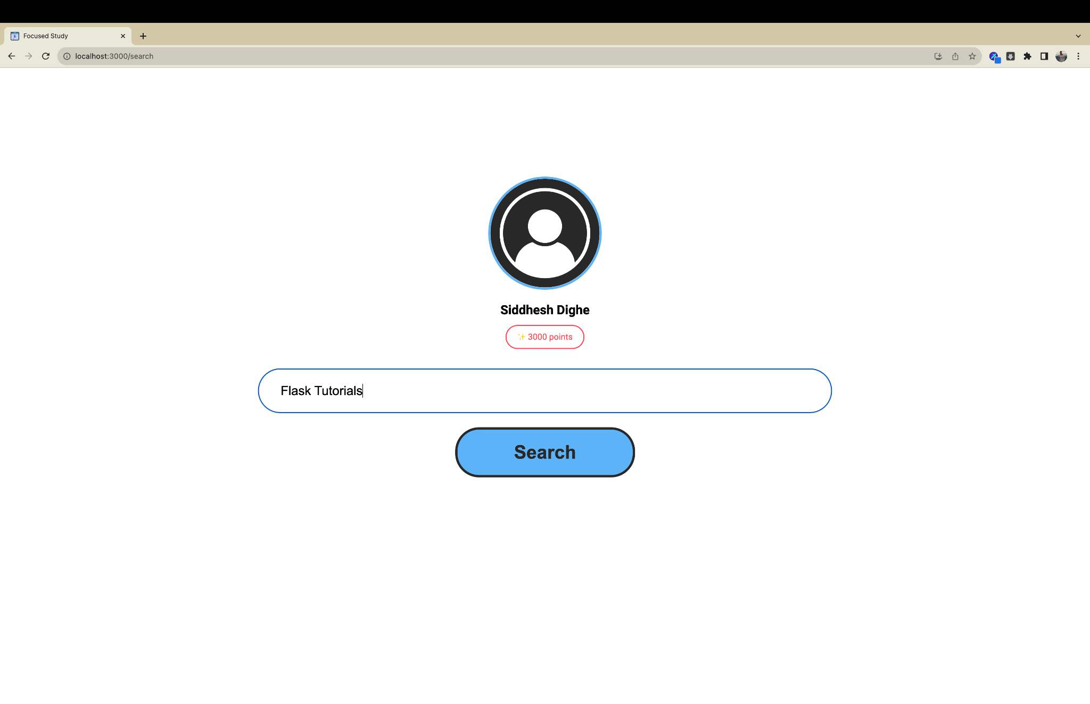
Search page

Slide 17
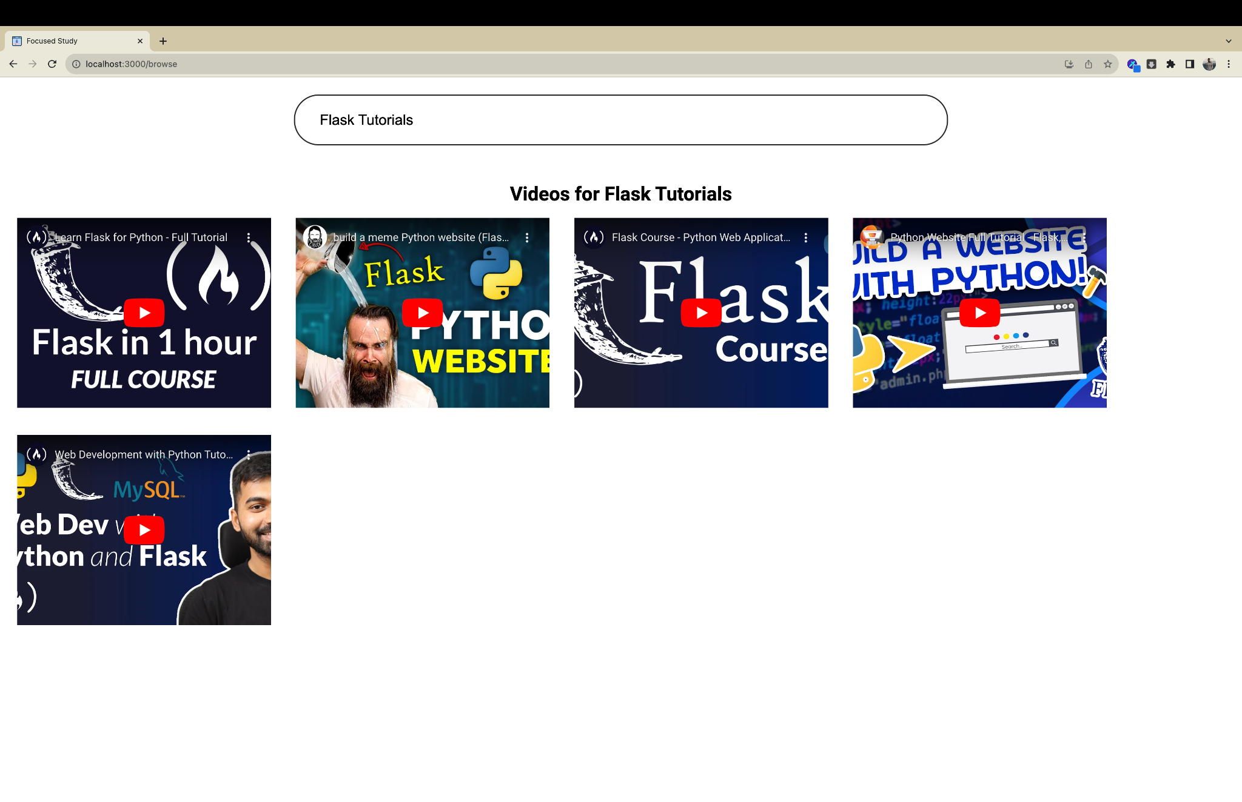
Suggested video page

Slide 18
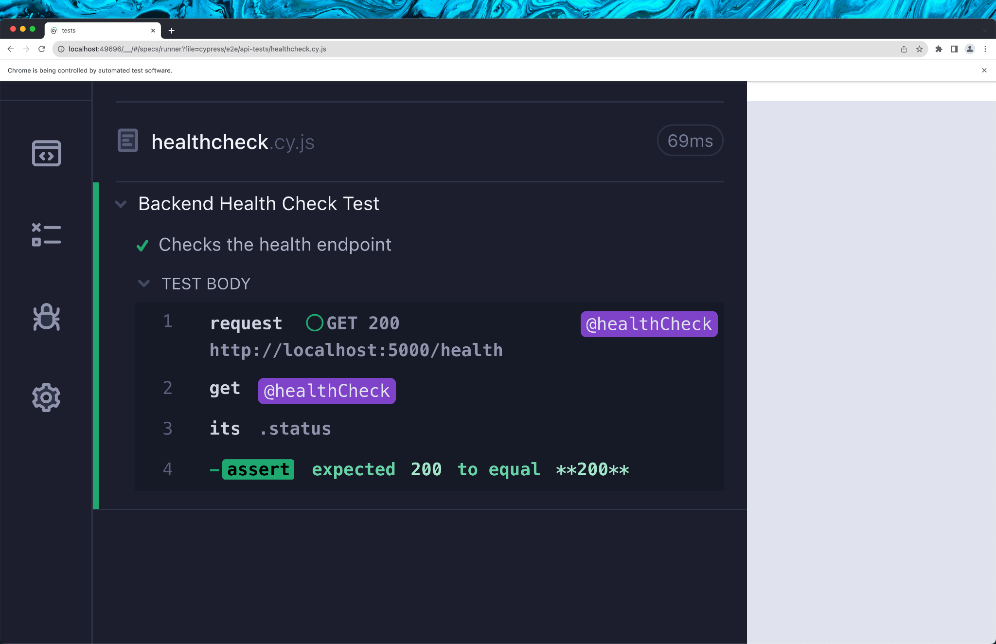
API Testing

Slide 19
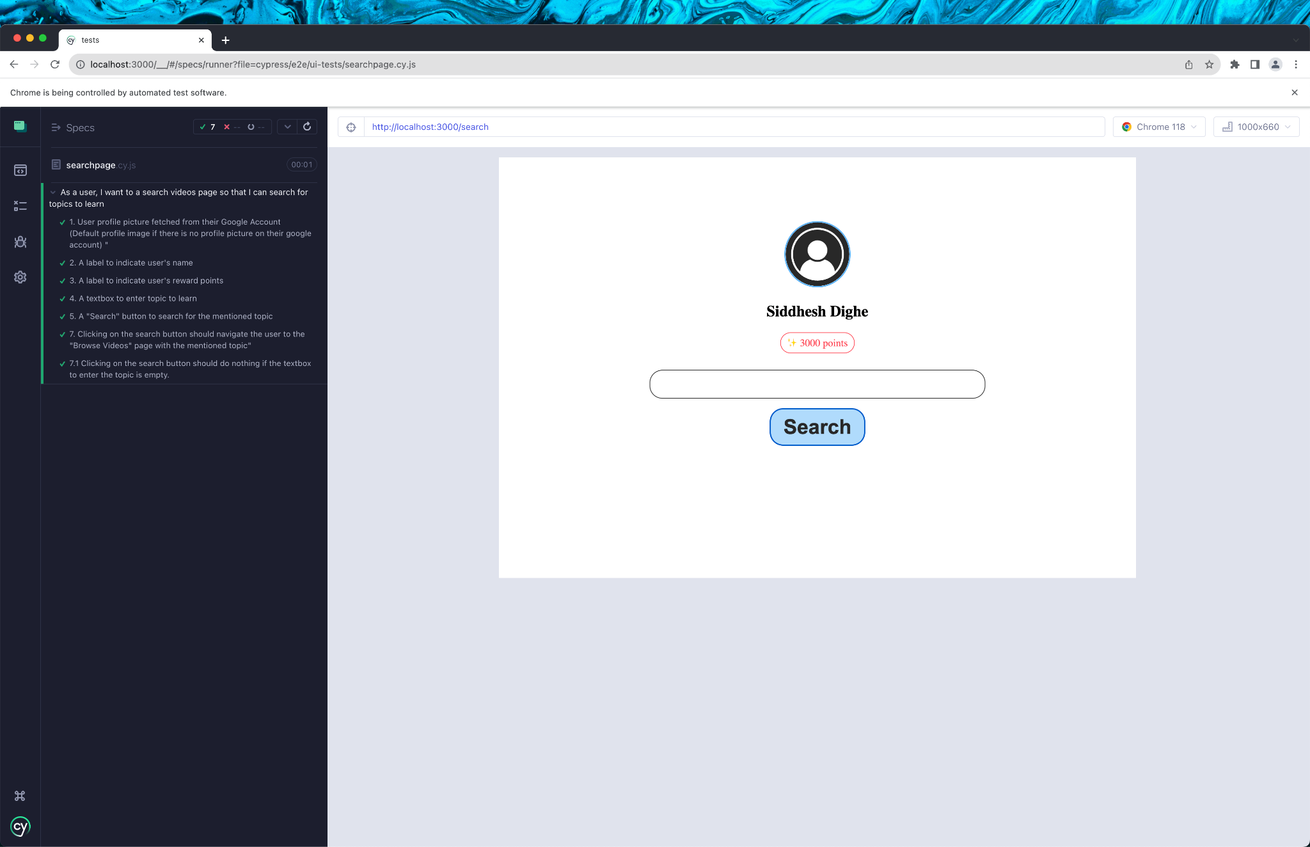
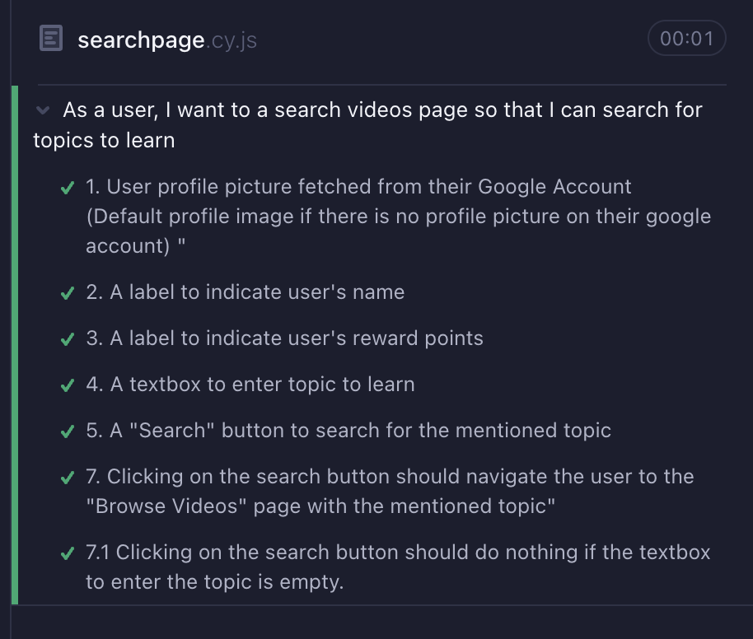
UI Testing

Slide 20
Thank You

